Slide 1

EMOJI PREDICTION TROUGH SENTIMENT ANALYSIS
Master’s degree in Artificial Intelligence
and Data Engineering
Data Mining and Machine Learning
Università di Pisa
Studente: Marcuccetti Gabriele

Slide 2

PROJECT OVERVIEW
01
02
03
04
05
06
INTRODUCTION
ABOUT DATASET
PREPROCESSING
GUI
CONCLUSION
CLASSIFICATION AND RESULT

Slide 3
01
INTRODUCTION

Slide 4
INTRODUCTION
Emojis are among the most important communication tools. There are potentially infinite emojis. A message, which could be misunderstood without emoji, acquire new meanings thanks to them:
«Ok … » → «Ok … 😂»

Slide 5
OUR GOAL
PURPOSE →
The main goal is to create an application that can analyze tweets and can associate an emoji to the input.
In the IOS and Android operating systems there is a function that associates, in a 1 to 1 correspondence, the respective emoji to a single word, but there is no function to associate an emoji with entire sentences.
To develop the final classifier used in application, it was necessary to pass through a supervised learning stage, which allowed us to test different classifier and choose the one that gave us better results.
CONTEXT →
HOW →

Slide 6
02
ABOUT DATASET

Slide 7
SOURCE OF DATASETS
https://www.kaggle.com/datasets/harriken/emoji-sentiment?select=ijstable.csv
About 700 emojis, and for each the relative polarities
https://www.kaggle.com/datasets/saurabhshahane/twitter-sentiment-dataset
About 100k rows ~ 20.9 MB
Each row containing a tweet and its associated sentiment
1 = Positive
-1 = Negative
0 = Neutral

Slide 8
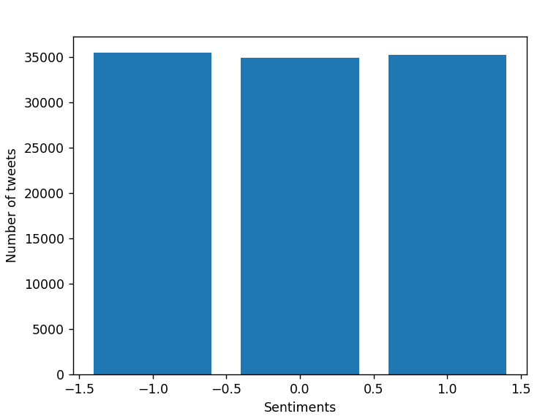
DATASET DISTRIBUTION
The data are balanced: Both class 1, 0 and -1 are, more or less, equally distributed, each of the 3 has about 35k tuples.

Slide 9
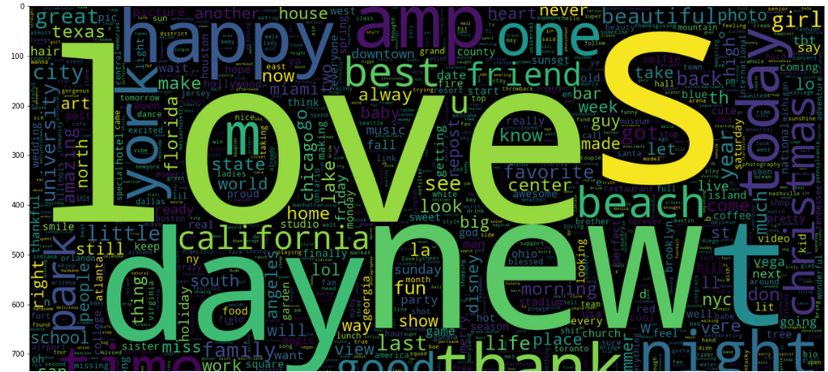
INITIAL DISTRIBUTION

Slide 10
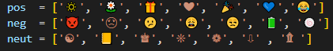
MOST REPRESENTATIVE EMOJI
For each category, the 7 most representative emojis were obtained: to do this, in the dataset containing the 700 emojis with their relative polarity, the 7 emojis with the highest value corresponding to that class were taken, for each class.

Slide 11
03
PREPROCESSING

Slide 12
MAIN STEPS
TRAINING DATA
TF-IDF TRANSFORMATION
PREPROCESSING
TOKENIZATION
REMOVE STOP WORDS
STEMMING
Remove all the @mentions, hashtag, re-tweet, hyperlinks, special characters, punctuations, multiple spaces and more consecutive letters.

Slide 13
04
CLASSIFICATION AND RESULTS

Slide 14
CLASSIFICATION
In this phase, the classifier is learned from the labelled training set. We trained different models and we tested them using the cross-validation procedure. Finally, the classifier that gave us better results (in terms of f-score and accuracy) was chosen as the final classifier to be adopted for the classification of tweets.

Slide 15
CLASSIFICATION The performances were evaluated with a 10-fold cross validation with a train test split of 80% and 20%.
K-NN classifier
Random forest classifier
Adaboost classifier
Decision tree classifier
We decided to test 7 different classifiers:
Linear support vector classifier
Multinomial classifier
Bernoulli classifier

Slide 16
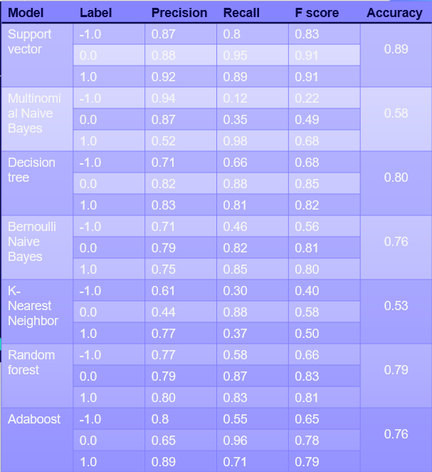
CLASSIFICATION

Slide 17
05
GUI

Slide 18
GUI
In this phase the unlabelled tweets are classified using the classifier trained in the supervised learning stage (the one that gives better results), after passing through the pre-processing phase and the text representation phase. The application looks like a window with two inputs and two buttons: a sentence is entered in the first input, the set of emoji associated with the sentence appears in the second; then there is a button to empty all the fields, and one to submit the sentence.

Slide 19
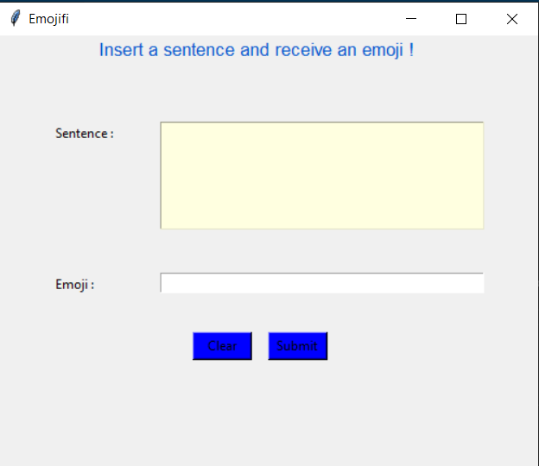
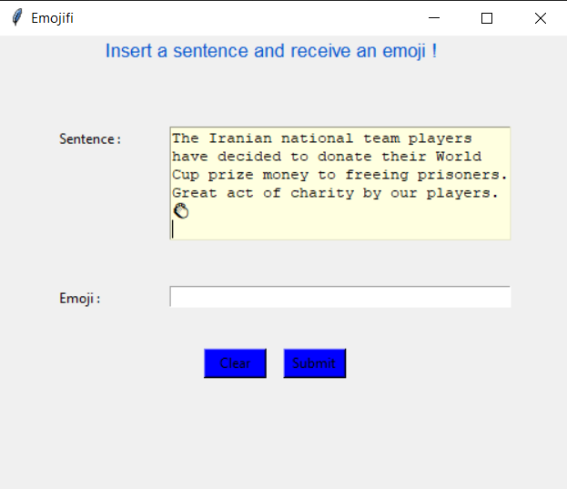
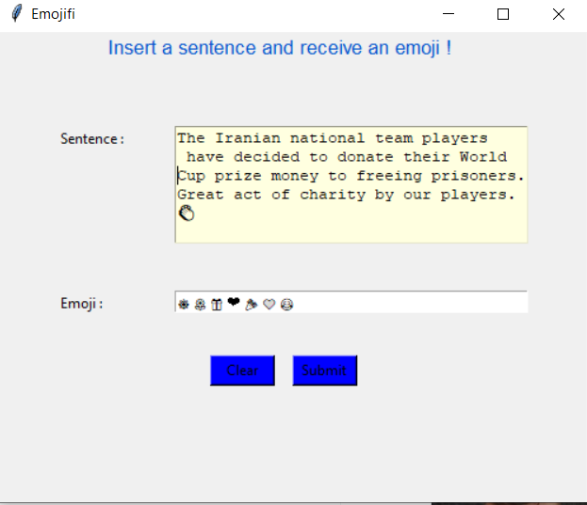

Slide 20
06
CONCLUSION

Slide 21
CONCLUSION
In summary, we started from two datasets: from the first we extracted the emoji associated with a certain emotion, from the second we trained a model that associates a specific emoji with a tweet. The model that obtained the best results both from the point of view of the f-score and from that of the accuracy is the Support Vector Classifier, with these metrics close to 90%. Subsequently, an interface was created that allows a user to enter a sentence: the sentence is processed, given as input to the model, which returns the possible emoji associated with the sentence.
Possible improvements may concern the ability to output a single emoji and not a set of emojis. The first approach to this project concerned precisely this possibility, but without obtaining positive results. Furthermore, there is a paper (https://ieeexplore.ieee.org/abstract/document/9544680) in which this possibility is discussed. In the work in question we first try to create a classifier with the machine learning methods that we have seen in the course and we come to the conclusion that it is not really suitable for the purpose. For this, neural networks are used, with which it is possible to obtain positive results (accuracy around 90%). Therefore, it is probable that to obtain good results there is the need to resort to these tools.

